Slide 1
Progressive Web Apps

Slide 2

stefan.kubinski@lakedice.com
Betriebswirtschaftslehre
Bilanzbuchhalterprüfung
Berufspilotenlizenz
Verheiratet + drei Kinder
Datenbank- und Softwareentwicklung
LAKEDICE OG

Slide 3














Slide 4
BlaBlaBla
Github
Jest
Clean Code
Frameworks (React, Angular…)

Slide 5
Progressive Web Apps (PWAs)
Should be reliable (load fast and provied offline functionality)
Should be fast (respond quickly to user interaction)
Should be engaging (feel like a native app on mobile devices)

Slide 6
Web Apps to PWAs
PWAs progressively enhance web apps to look and feel like native apps.

Slide 7
Progressive Enhancement
Starting Point | Near Future | Future
Existing (legacy) App | Add some features | Use multiple PWA features
Existing (modern) App | Implement some core PWA features | Completely convert to PWA
Upcoming project | Fully implement PWA from the start | Complete PWA

Slide 8
Smartphone Nutzung
Push Notifications
Home Screen Icons
Offline
Native Device Features

Slide 9
Core Blocks
Service Workers
Background Sync
Caching
Other PWA Stuff
Web Push
Application Manifest
Geolocation API
Responsive Design
Media API

Slide 10
PWAs vs. Native Apps vs. Web Pages
 | Capability | Reach
Native Apps | Access Device Features, Leverage OS | Top 3 Apps Win, Rest Loses
Web Apps | Highly Limited Device Feature Access | High Reach, No Borders
PWAs | Access Device Features, Leverage OS | High Reach, No Borders

Slide 11
Outline
Basics
App Manifest
Service Workers
Installation
Promise and Fetch, Service Worker Caching
Advanced Caching, Indexed DB and Dynamic Data
Responsive UI, Background Sync
Web Push Notifications
Native Device Features
Round Up & Quiz

Slide 12
D1: Create App
npm init
npm install http-server
add start http-server to package.json
npm start
http://localhost:8080
code .
add Bootstrap or other UI Framework

Slide 13
PWA = WebApp + Manifest + ServiceWorker

Slide 14
manifest.json
{
"name": "Einkaufsliste", -> Long name of the app (e.g. splashscreen)
"short_name": "Einkaufsliste", -> Short name of the app (e.g. below icon)
"start_url": "/index.html", -> Page to load at startup
"scope": ".", -> Pages to „pwarize“
"description": "A sample PWA for testing purposes", -> e.g. as a favorite
"display": "standalone", -> Look like a standalone app
"background_color": "#2f3d58", -> Background color while loading
"theme_color": "#2f3d58", -> Color on top bar in task switcher
"dir": "ltr", -> reding direction
"lang": "en-US", -> main language
"orientation": "portrait-primary", -> Set default orientation
"icons": […]
}

Slide 15
icons in manifest.json
{
…
"icons": [
{
"src": "/src/images/icons/app-icon-48x48.png",
"type": "image/png",
"sizes": "48x48"
},
{
"src": "/src/images/icons/app-icon-96x96.png",
"type": "image/png",
"sizes": "96x96"
}
]
}

Slide 16
related applications in manifest.json
{
…
"related_applications": [
{
"platform": "play",
"url": "https://play.google.com/store/apps/details....",
"id": "com.example.app"
}
]
}

Slide 17
Safari
<meta name="apple-mobile-web-app-capable" content="yes">
<meta name="apple-mobile-web-app-status-bar-style" content="black">
<meta name="apple-mobile-web-app-title" content="PWADemo">
<link rel="apple-touch-icon" href="/src/images/icons/apple-icon-57x57.png" sizes="57x57">
<link rel="apple-touch-icon" href="/src/images/icons/apple-icon-60x60.png" sizes="60x60">
<link rel="apple-touch-icon" href="/src/images/icons/apple-icon-72x72.png" sizes="72x72">
<link rel="apple-touch-icon" href="/src/images/icons/apple-icon-76x76.png" sizes="76x76">
<link rel="apple-touch-icon" href="/src/images/icons/apple-icon-114x114.png" sizes="114x114">
<link rel="apple-touch-icon" href="/src/images/icons/apple-icon-120x120.png" sizes="120x120">
<link rel="apple-touch-icon" href="/src/images/icons/apple-icon-144x144.png" sizes="144x144">
<link rel="apple-touch-icon" href="/src/images/icons/apple-icon-152x152.png" sizes="152x152">
<link rel="apple-touch-icon" href="/src/images/icons/apple-icon-180x180.png" sizes="180x180">

Slide 18
Internet Explorer
<meta name="msapplication-TileImage" content="/src/images/icons/app-icon-144x144.png">
<meta name="msapplication-TileColor" content="#fff">
<meta name="theme-color" content="#3f51b5">

Slide 19
Chrome/Edge Developer Tools

Slide 20
Service Workers
JS
JS
JS
Runs on one single thread, attached to the HTML pages
HTML
HTML
HTML
Runs on additional thread, decoupled from HTML pages
Service Worker
Manages ALL pages of a given scope
Lives on even after pages are closed
Listen to specific events

Slide 21
Events (in Service Worker)
Event | Source
FETCH | Browser or page related JavaScript initiates a fetch (HTTP request)
PUSH NOTIFICATIONS | Push notification (from server)
NOTIFICATION INTERACTION | User interacts with displayed notification
BACKGROUND SYNC | Background sync event (internet connection is restored)
LIFECYCLE

Slide 22
Registration
index.html
app.js
service worker

Slide 23
D2: Add a service worker

Slide 24
D3: Handle Installation
More about the "Web App Install Banner" (including Requirements): https://developers.google.com/web/fundamentals/engage-and-retain/app-install-banners/

Slide 25
Emulate and Simulate
https://developer.android.com/studio/index.html
We only install it to get easy access to the Android Virtual Device (AVD) Manager though. You can access that Manager under "Tools" => "Android" => "AVD Manager".
Detailed instructions on how to create a device with it can be found here: https://developer.android.com/studio/run/managing-avds.html
Updating Chrome on the Virtual Device
With an emulated device up and running, you're well-prepared to test your manifest.json file.
You can easily update Chrome on your virtual device though. Get an updated APK (basically the app installation file) from this link: https://www.apkmirror.com/apk/google-inc/chrome/#variants
Feel free to choose the latest one, download and install it. Give the device the permission to install from "unsafe" sources. If it fails, try a different APK version.

Slide 26
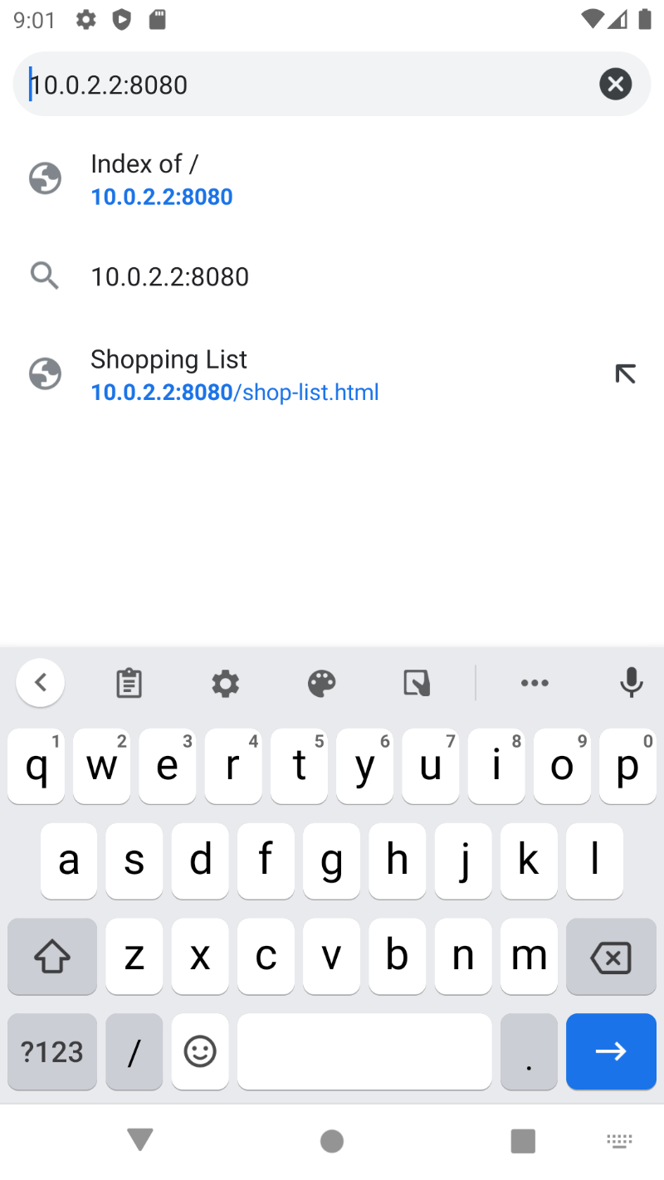

Slide 27
PWA Application Icon Generator Free Online Tool (crawlink.com)
PWABuilder
Web App Manifest - Browser Support: http://caniuse.com/#feat=web-app-manifest
MDN Article on the Web App Manifest (includes List of all Properties): https://developer.mozilla.org/en-US/docs/Web/Manifest
A detailed Web App Manifest Explanation by Google: https://developers.google.com/web/fundamentals/engage-and-retain/web-app-manifest/

Slide 28
Outline
Basics
App Manifest
Service Workers
Installation
Promise and Fetch, Service Worker Caching
Advanced Caching, Indexed DB and Dynamic Data
Responsive UI, Background Sync
Web Push Notifications
Native Device Features
Round Up & Quiz

Slide 29
WIFI – CODE - REPEAT

Slide 30
Promise and Fetch

Slide 31
Javascript = SINGLE Threaded
Data from Server
Other long running operation
Wait
2 seconds
Es könnte so einfach sein, isses aber nicht…

Slide 32
Javascript = SINGLE Threaded
Data from Server
Other long running operation
Wait
2 seconds

Slide 33
Callback Demo
console.log("BEFORE TIMEOUT!")
setTimeout(function() {
console.log("TIMEOUT COMPLETE")
}, 3000);
console.log("AFTER TIMEOUT!")

Slide 34
Promise Demo
console.log('BEFORE TIMEOUT!')
var promise = new Promise(function(resolve, reject) {
setTimeout(function() {
resolve('TIMEOUT COMPLETE')
}, 3000);
});
promise.then(function(text) {
console.log(text);
});
console.log('AFTER TIMEOUT!')

Slide 35
Rejecting Promises

Slide 36
Then…Catch…

Slide 37
Where do we use promises in our code?
app.js
sw.js

Slide 38
Fetch
httpbin.org/ip
httpbin.org/post

Slide 39
Polyfills
Use promises & fetch on older browsers

Slide 40
Links
Introduction to Promises (MDN): https://developer.mozilla.org/en-US/docs/Web/JavaScript/Reference/Global_Objects/Promise
Introduction to Promises (Google): https://developers.google.com/web/fundamentals/getting-started/primers/promises

Slide 41
Before caching items
Which application
Basic layouting

Slide 42
Service Worker Caching (Basic)

Slide 43
Why?
Offline access
Poor connection
No connection
Lie-Fie!

Slide 44
Cache API
Service Worker
Cache
JavaScript
on Pages
Key: Request
Value: Response
Cache Data can be retrieved instead of sending network request

Slide 45
Identify the app shell
Static content that is basic for our app
Cache the identified content in the install event of the service worker

Slide 46
Demo STATIC caching

Slide 47
Dynamic caching
Cache new requests in the fetch event dynamically

Slide 48
Demo DYNAMIC caching

Slide 49
Cache versioning

Slide 50
Links
About Cache Persistence and Storage Limits: https://jakearchibald.com/2014/offline-cookbook/#cache-persistence
Learn more about Service Workers: https://developer.mozilla.org/en/docs/Web/API/Service_Worker_API
Google's Introduction to Service Workers: https://developers.google.com/web/fundamentals/getting-started/primers/service-workers

Slide 51
Outline
Basics
App Manifest
Service Workers
Installation
Promise and Fetch, Service Worker Caching
Advanced Caching, Indexed DB and Dynamic Data
Responsive UI, Background Sync
Web Push Notifications
Native Device Features
Round Up & Quiz

Slide 52
WIFI – CODE - REPEAT

Slide 53
Improve existing Application
Google Firebase
Add functionality (read, delete, insert)
Show bug with fetch / use catch, then and finally

Slide 54
Advanced Caching
Cache on demand
Offline fallback page
Cache Strategies
Cache with network fallback
Cache only
Network only
Network with cache fallback
Cache then network
Cache then network & dynamic caching
Cache then network with offline support

Slide 55
Cache on demand
if ('caches' in window)
{
caches.open('user-requested')
.then(function(cache) {
cache.add('');
});
}

Slide 56
Offline fallback
.catch(function(error) {
//do not throw exception when fetching fails
//but provide offline page
return caches.open(CACHE_STATIC_NAME)
.then(function(cache) {
return cache.match('/offline.html');
});
});

Slide 57
Cache with network fallback (now)
Page
1
4
Service Worker
Network
3
2
Cache
Speed
Not up to date

Slide 58
Cache only
Page
1
Service Worker
Network
3
2
Cache

Slide 59
Network only
Page
1
Service Worker
2
Network
Cache

Slide 60
Network with cache fallback
Page
1
Service Worker
4
Network
2
3
Cache
Not so fast
Network timeout

Slide 61
Network with cache fallback
Page
1
Service Worker
4
Network
2
3
Cache
Not so fast

Slide 62
Cache then network
Page
5
1
1
Service Worker
Network
2
3
2
Cache
Get fast but update frequently
4

Slide 63
Indexed DB and Dynamic Data

Slide 64
Dynamic Caching vs. Caching of Dynamic Content
Page
Page
Cache
Service Worker
Indexed DB
Service Worker
Network
Network

Slide 65
Indexed DB
Transactional (=all or none)
Key-Value
Database in the Browser
JSON Data
Async access possible = Serviceworker ready!
Database (one per App) – Object Store (Table) – Object
Well supported in nearly all browsers

Slide 66
API for Indexed DB
Clunky
jakearchibald/idb package
import idb.js (index.html + sw.js)

Slide 67
Getting started
importScripts('/js/idb.js');
…
var dbPromise = idb.open('damageStore', 1, function(db) {
if (!db.objectStoreNames.contains('damages')) {
db.createObjectStore('damages', {keyPath: 'id'});
}
});
…

Slide 68
Added basic functionality (helper.js)
Add dbPromise
Implement writeData, readAllData, clearAllData, deleteItemFromData

Slide 69
Implement new caching
var url = 'https://pwademo-66c7b-default-rtdb.europe-west1.firebasedatabase.app'; //-/damagelog.json';
if (event.request.url.indexOf(url) > -1) {
event.respondWith(
fetch(event.request)
.then(function(res) {
//cache.put(event.request, res.clone()); <--store db response in cache
var clonedResponse = res.clone();
clearAllData('damages')
.then(function() {
return clonedResponse.json()
})
.then(function(data) {
console.log("DATA->", data);
for (var key in data) {
writeData('damages', data[key]);
console.log(data[key]);
}
});
return res;
})
);
}

Slide 70
Links
jakearchibald/idb: IndexedDB, but with promises (github.com)
IndexedDB - Web API Referenz | MDN (mozilla.org)

Slide 71
Outline
Basics
App Manifest
Service Workers
Installation
Promise and Fetch, Service Worker Caching
Advanced Caching, Indexed DB and Dynamic Data
Responsive UI, Background Sync
Web Push Notifications
Native Device Features
Round Up & Quiz

Slide 72
Repeat

Slide 73
Implementation of App

Slide 74
Docker
Docker vereinfacht die Bereitstellung von Anwendungen, weil sich Container, die alle nötigen Pakete enthalten, leicht als Dateien transportieren und installieren lassen. Container gewährleisten die Trennung und Verwaltung der auf einem Rechner genutzten Ressourcen. Das umfasst laut Aussage der Entwickler: Code, Laufzeitmodul, Systemwerkzeuge, Systembibliotheken – alles was auf einem Rechner installiert werden kann
docker compose
demo

Slide 75
Caching (race condition)
orderentries

Slide 76
Indexed DB

Slide 77
Background Sync
App
Wants to send data to the server
temporary store data
Register sync task
No internet connection
SYNC EVENT
Indexed DB
Service Worker
Server
(API…)
Connectivity (re)established

Slide 78
Implementation
register submit listener on form
event.preventDefault
check for data
register background sync task (Chrome and Edge)
create new store in IndexedDB
write data
show something?
if sw or sm is not supported -> create else
register ‚sync‘ event in service worker

Slide 79
Outline
Basics
App Manifest
Service Workers
Installation
Promise and Fetch, Service Worker Caching
Advanced Caching, Indexed DB and Dynamic Data
Responsive UI, Background Sync
Web Push Notifications
Native Device Features
Round Up & Quiz

Slide 80
Web Push and Notifications
Request permissions
add button
show only when notifications are supported
handle click event
handle user response
Create notification
Transfer to service worker (prep for push handling)
Improve options
Add actions
Remote debugging

Slide 81
Push Notifications
App
1 User allows notifications
Send push notification
Backend server
Browser vendor push server
2 Create new subscription
Display notification
Check for existing subscriptions
Service Worker
„push“ event

Slide 82
Subscribe
Check for subscription or register a new one
VAPID approach (security)
public and private key
Install web-push, create script in package.json
Subscribe
endpoint: „https….“
keys:
auth: „dc….“
p256dh: „B0q8SMMRgd….“
unregistering of service werker invalidates subscriptions

Slide 83
Outline
Basics
App Manifest
Service Workers
Installation
Promise and Fetch, Service Worker Caching
Advanced Caching, Indexed DB and Dynamic Data
Responsive UI, Background Sync
Web Push Notifications
Native Device Features
Round Up & Quiz

Slide 84
Outline
Basics
App Manifest
Service Workers
Installation
Promise and Fetch, Service Worker Caching
Advanced Caching, Indexed DB and Dynamic Data
Responsive UI, Background Sync
Web Push Notifications
Native Device Features
Round Up & Quiz

Slide 85
Backend
Google Firebase
Realtime Database
No authentication for this purpose

